Slide 1
Decision Tree Classifier
Deepayan Chakrabarti (deepay@utexas.edu)

Slide 2
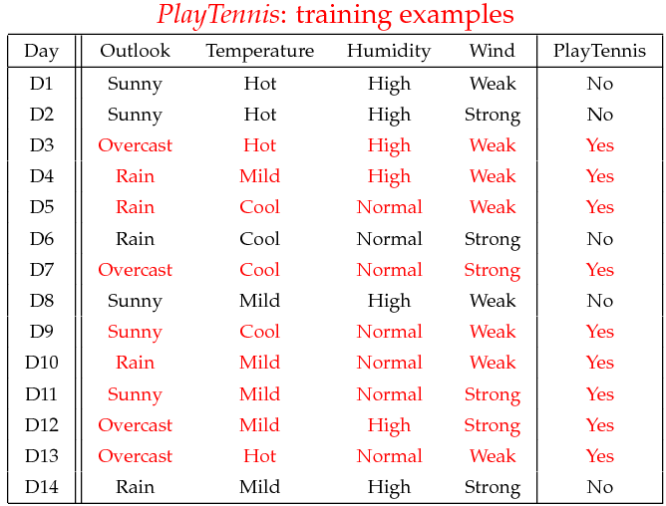
Decision Trees

Slide 3
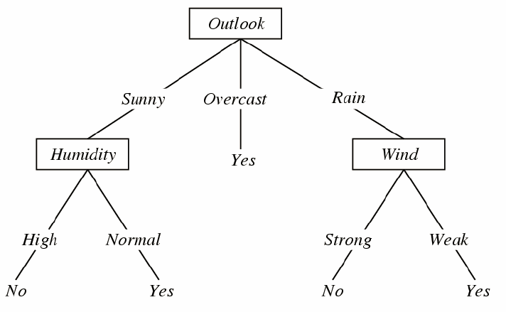
Decision Tree
The PlayTennis Decision Tree

Slide 4
Decision Tree
The Decision Tree need not include all features
Knowing the decision tree, coding it up is easy
A sequence of questions with Yes/No answers
If-then-else
Today
How do we build the tree?
The PlayTennis Decision Tree

Slide 5

Decision Tree
Building the Decision Tree
Choose the best feature to split the datapoints
Outlook
?
Humidity
Wind
X₁ ➔ y₁ X₂ ➔ y₂
X₃ ➔ y₃

Slide 6
Decision Tree
Building the Decision Tree
Choose the best feature to split the datapoints
We have a tree
Root = Outlook
3 children
Outlook=sunny
Outlook=overcast
Outlook=rain
Outlook
sunny
rain
overcast
?
?
?

Slide 7
Decision Tree
Building the Decision Tree
Choose the best feature to split the datapoints
Repeat the process for each child
Stop if
A child is pure
all positive, or
all negative
We run out of features
Outlook
sunny
rain
overcast
Wind
strong
weak

Slide 8
Decision Tree
What feature is best?
Consider one particular child in the tree
Available features:
Humidity
Wind
Training examples with Outlook=Sunny:
60 positive examples
40 negative examples
If a test datapoint matched this child’s features
Would you predict positive or negative?
Outlook
sunny
All training examples with Outlook=sunny

Slide 9
Decision Tree
What feature is best?
Best feature ➔ one which creates purest splits of data
60 positive, 40 negative
60 positive, 40 negative
Humidity
Wind
high
normal
strong
weak
10 positive, 40 negative
50 positive, 0 negative
20 positive, 20 negative
40 positive, 20 negative
Purer split of data

Slide 10
Decision Tree
How do we measure purity of split?
Let p = fraction of positive examples
p = P / (P + N)
Let n = fraction of negative examples
n = N / (P + N)
Entropy = (P+N) * (-p * log₂ p – n * log₂ n)
Minimum entropy per example = 0.0
if either p=0 or n=0
Maximum entropy per example = 1.0
if p = n = 0.5
60 positive, 40 negative
# examples
entropy per example

Slide 11
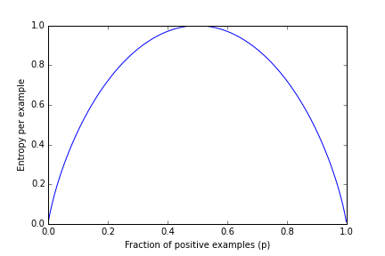
Decision Tree
How do we measure the purity of a split?
Maximum at p=n=0.5
Minimum at p=0 or n=0
Entropy per example = -p * log₂ p – n * log₂ n

Slide 12
Decision Tree
How do we measure the purity of a split?
Entropy per example = -0.6 * log 0.6 – 0.4 * log 0.4 = 0.97
Entropy = 0.97 * 100 = 97
60 positive, 40 negative
Wind
strong
weak
20 positive, 20 negative
40 positive, 20 negative
Entropy per example = -0.5 * log 0.5 – 0.5 * log 0.5 = 1.0
Entropy = 1.0 * 40 = 40
Entropy per example = -0.67 * log 0.67 – 0.33 * log 0.33 = 0.57
Entropy = 0.57 * 60 = 34.2

Slide 13
Decision Tree
How do we measure the purity of a split?
Information about wind reduces entropy
Less entropy ➔ more purity ➔ better predictions
60 positive, 40 negative
Entropy before split = 97
(wind conditions unknown)
Wind
strong
weak
20 positive, 20 negative
40 positive, 20 negative
(wind conditions known)
Entropy after split = 40 + 34.2 = 74.2
Entropy = 40
Entropy = 34.2

Slide 14
Decision Tree
What feature is best?
For each possible feature, calculate reduction in entropy
Best Feature ➔ greatest entropy reduction
60 positive, 40 negative
60 positive, 40 negative
Humidity
Wind
high
normal
strong
weak
10 positive, 40 negative
50 positive, 0 negative
20 positive, 20 negative
40 positive, 20 negative

Slide 15
Decision Tree
One potential problem
What happens if there are many features?
Each feature
gives extra information
➔ reduces entropy
➔ leading to the addition of some feature to the decision tree
➔ very deep trees
➔ might overfit
Solution:
Prune the tree

Slide 16
Decision Tree
Pruning the tree
First idea: Pre-pruning
Don’t add a new feature to the tree if the entropy reduction is not enough
Risk
Several feature may be important in combination, but not judged to be important individually

Slide 17
Decision Tree
A
Pruning the tree
Second idea: Post-pruning
Build the full tree
Then remove/fix parts of it
Example
Remove a subtree
Lots of heuristics
B
C
4
5
1
2
3
A
B
6
4
5

Slide 18
Summary
Decision tree algorithms are based on heuristics
One decision node is added at a time
Entropy reduction (also called “information gain”)
other methods are also used
Heuristic pruning methods to avoid overfitting

Slide 19
Summary
Advantages
Decision trees make few assumptions about the data
Logistic regression requires some unknown factor
Small values ➔ negative class
Large values ➔ positive class
No such assumption for decision trees
Easy to interpret, explain, and code
Just an if-then-else statement

Slide 20
Summary
Disadvantages
Decision trees can be unstable
Slightly different training data can result in very different trees
Overfitting can be a problem

Slide 21
Decision Tree
How do we measure purity of a split?
Entropy
measures “information”
“How much would I need to speak to tell someone the class of each datapoint?”
P=100, N=0
“Everyone positive!”
P=0, N=100
“Everyone negative!”
P=50, N=50
Must say class for each datapoint
Needs a lot of communication
60 positive, 40 negative

Slide 22
Decision Tree
How do we measure purity of split?
P=100, N=0
“Everyone positive!”
Entropy = 0 bits of information
P=0, N=100
“Everyone negative!”
Entropy = 0 bits of information
P=50, N=50
Must say class for each datapoint
Entropy = 100 bits of information
60 positive, 40 negative

